Slide 1


Practical Guide and Risk Prevention of L/C for Countries along the “Belt and Road”
“One Belt One Road”Sino-Africain Cross-Border E-Commerce Online Training Program（Ⅱ）
“一带一路”沿线国家信用证实务及风险防范
YAN YUAN

Slide 2
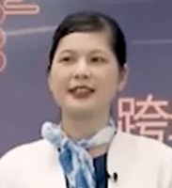
Self-introduction
YAN YUAN :
Professor, Senior credit manager.
Major leader（专业带头人） in Cross-border e-commerce of GDMEP.
Graduated from National Sun Yat-sen University, Worked in Bank of China and foreign trade company after graduation.
Have been a teacher for 18 years.
Specialize in L/C practice, has a deep study at L/C risk prevention.
The international trade technical consultant and cross-border e-commerce operation expert of some enterprises.

Slide 3

CONTENTS
01
What’s the L/C?
02
What’s the L/C like?
03
How to check and amend the L/C ?
04
How to make the foreign trade documents under the L/C?
05
How to prevent the L/C risk?

Slide 4

PART ONE
What’s the L/C?

Slide 5




What’s the L/C?
1.1 The main types of cross-border e-commerce
B2B
B2C
L/C

Slide 6
What’s the L/C?
1.2 Modes of international payment
Telegraphic Transfer（T/T）
Mail Transfer（ M/T）
Remittance by Banker’s Demand Draft（D/D）
Remittance
Documents against Payment (D/P)
Collection
Documents against Acceptance (D/A)
Letter of credit （L/C）

Slide 7
What’s the L/C?
1.3 Definition of Letter of Credit
According to the Uniform Customs and Practice for Documentary Credits(UCP600)
Credit means any arrangement, however named or described, that is irrevocable and thereby constitutes a definite undertaking of the issuing bank to honour a complying presentation.
信用证意指一项安排，无论其如何命名或描述，该安排不可撤销并因此构成开证行对于相符交单予以承付（Honor）的确定承诺。

Slide 8
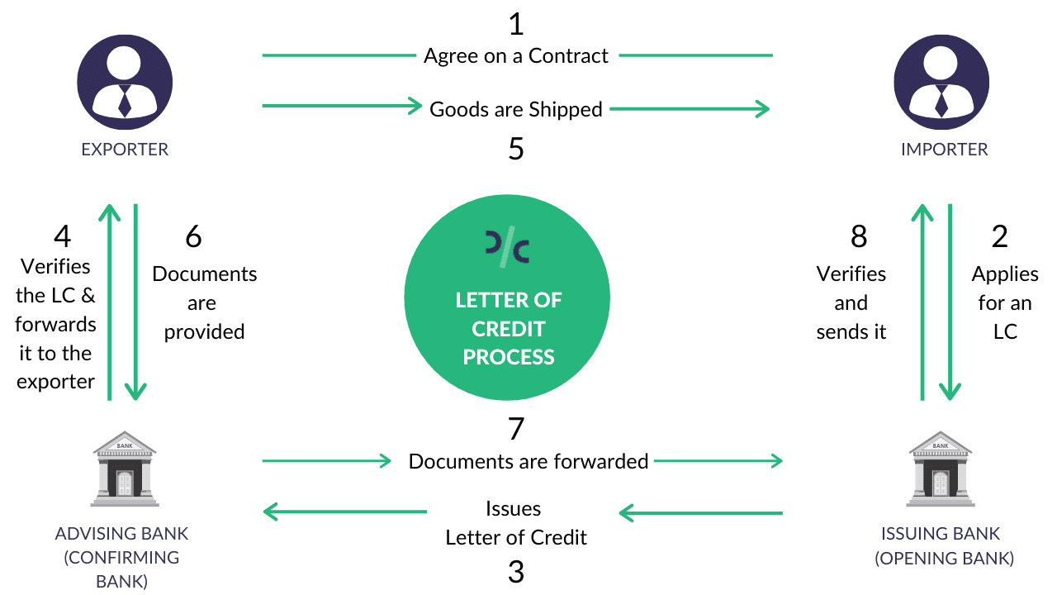
What’s the L/C?
1.4 Circulation of Letter of Credit

Slide 9
PART TWO
What’s the L/C like?

Slide 10
What’s the L/C like?
2.1 SWIFT LC ——the most commonly used
SWIFT: Society for Worldwide Inter bank Financial Telecommunication
It’s an association founded in 1973, more than 9,000 banks participate in it .
It’s an automated international financial telecommunication network.
To make the international payment more convenient.

Slide 11
What’s the L/C like?
2.2 An actural LC from Kenya

Slide 12
PART THREE
How to check and amend the L/C ?

Slide 13

How to check and amend the L/C ?
Do the practice :
Check the L/C according to the contract, point out the discrepancies and propose amendments.

Slide 14
THANK
YOU

